Slide 1


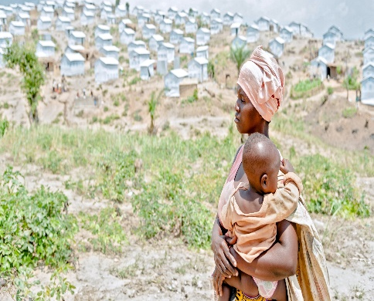

Management Response
Corporate Thematic Evaluation of UN-Women’s Contribution to Humanitarian Action

Slide 2
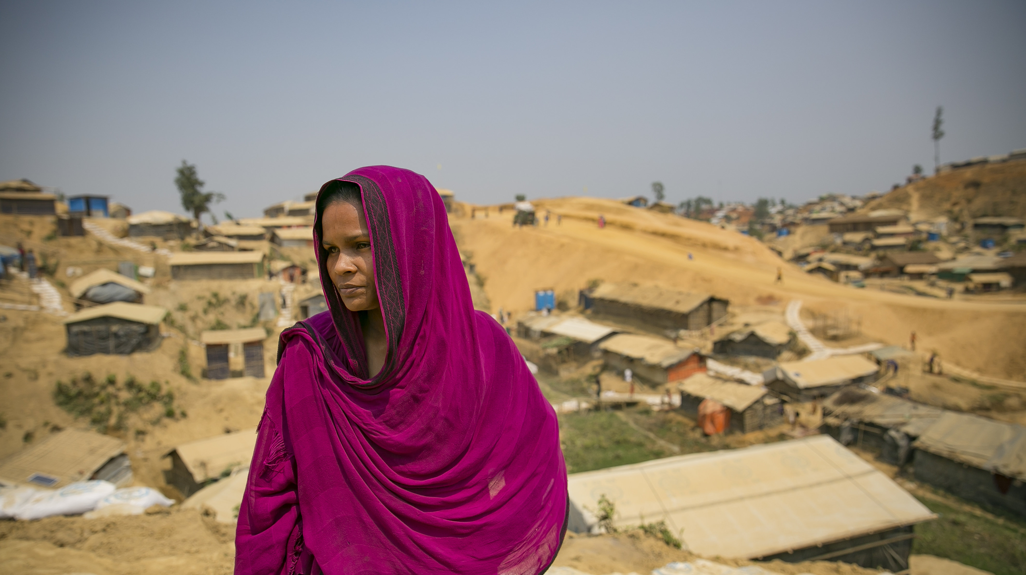
Contextualizing The Management Response
1- Heightened Vulnerability
2- Accountability gaps

Slide 3
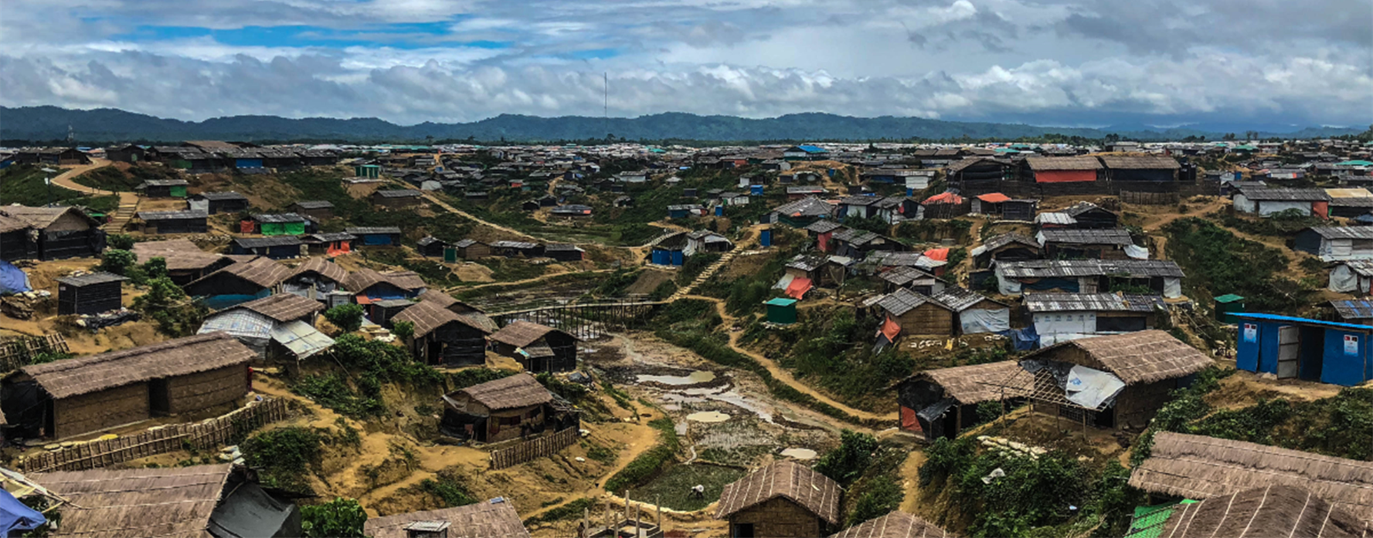
Heightened Vulnerability in a World in Crisis: An Imperative for Action
1 in 5 girls married before age 18
131 million
girls out of school
60% of preventable maternal deaths occur in crises
141.6m in need of humanitarian assistance
68 m displaced by conflict
19.2 m displaced by disasters
500 adult illiterate women. And girls 2.5 times more likely to drop out
Women have a higher chance of dying and die earlier than men when disaster strikes
1 in 5 women suffer from SGBV in crises
Average displacement is 17-26 years
Overemphasis on victimhood

Slide 4
A mixed picture: Normative and policy gains and persistent gaps in upholding gender commitments
The World Humanitarian Summit – Agenda for Humanity Commitments
54% of HRPs lack gender analysis
Less than 60% of the reporting countries held consultations with local women’s organizations
Merely 20% of countries had an independent gender analysis feeding into the humanitarian planning process
Only 1.15% of financed HRP projects is targeted programming and 32% mainstream gender
The inaugural Accountability Framework Report developed by UN Women on behalf of the IASC Gender Reference Group reveals inconsistency in the adoption and implementation of the Gender Policy
Global compact for Refugees and The New York Declaration on Refugees and Migrants
The IASC Gender Policy and Accountability Framework
Sendai Framework for Action for DRR
Notes:
Global Level –
The IASC showed inconsistency in the adoption and application of its gender policy. For the Principal’s output in 2018, only one-third of its published decisions reflected inclusion of the commitments to gender. Most concerningly, they were only reflected through reference to PSEA and AAP in the Strategic Priorities set for the IASC for 2018-2019, less than 12 months after the Gender Policy was officially endorsed.
The workplans for the Working Group and the Emergency Directors Group covering 2018 were rolled over from 2017, before the Gender Policy was adopted.
2018 did see the launch of the IASC’s Gender and Age Marker and the IASC Gender Handbook for Humanitarian Action, which are landmark tools for the focused integration of gender into the coordination of humanitarian action. However, it is worth reflecting that both these resources were developed by GenCap and the GRG respectively, both of which are focused on gender in humanitarian action.
Conversely, the other key output of the Working Group in 2018 – the Protocols on Humanitarian System-Wide Scale-Up Activation – which were developed without gender-in-humanitarian-action technical capacity input, had very limited content from the Gender Policy.
All of this demonstrates that without direct GiHA technical capacity membership in the IASC, the humanitarian community will need to remain vigilant in its monitoring of the IASC’s delivery of it commitments to GiHA
Feedback from the global clusters into the AF monitoring process was limited which was indicative of a lack of knowledge of the 2017 IASC Gender Policy and reporting obligations to the Accountability Framework. This is an issue that will need to be addressed by the Principals, the Operational Policy and Advocacy Group (OPAG) and the Gender Reference Group. The former for reiterating to its constituent parts the IASC’s stated policy and reporting commitments and the latter two for socializing the policy contents and the AF’s added value to the IASC.
Field Level –
Whilst it is welcoming to see 90% of the HNOs published in 2018 had some degree of gender analysis included on the impact of the given crises on women, men, girls and boys (beyond just protection and reproductive health issues) and 55% of them demonstrated use of SADD in at least half of the clusters contained within, only 45% of them (9 of 20) contained both. Furthermore, the issues identified in the gender analysis was inconsistently applied to the prioritized actions of the clusters/sectors in the HNOs and the HRPs. It is worth noting that only 5 of the reporting countries had an independent gender analysis develop as a resource to feed into the humanitarian planning process.
Looking at specific action plans that address the specific needs (though not exclusive) of women and girls, the Response plans were reviewed for inclusion of action on sexual and reproductive health (67% of the 20 HRPs included SRH), women’s economic empowerment (67%), mitigation and response to GBV (65%). These are obviously encouraging numbers, but demonstrate that there is still a long way to go.
70% and 100% of the HRPs included strategies and plans for PSEA and AAP, respectively. But what was often missing was details on how women and girls would be able to equally and safely access the feedback and complaints mechanisms that are central to both. What is also interesting is that despite a ubiquitous referral to AAP and participation of the affected population in the HRPs, only 56% of them had direct consultation with local women’s organizations in the planning and decision making process.
In terms of functioning gender reference/working groups at the country level, 44% of the reporting countries (11 of 25) had them functioning in 2018 – and of this group, half had gender analysis and demonstrated use of SADD in their planning documents (HNO/HRP).
Also worth noting is only 3 of the 19 HCTs which kept records of attendees in 2018 had gender parity.
Conclusion
The AF report marks the first step in an ongoing monitoring process of the integration of gender equality and the empowerment of women and girls in the global and field level humanitarian architecture. Providing a snapshot of how things stand after the first 12 months of the 2017 IASC Gender Policy’s existence.
What is evident from the results is the need for continued vigilance and technical support to the IASC and its structures, in order to assist them meet their commitments and obligations to the crisis affected women and girls, as well as men and boys.
The IASC must have in place GiHA technical capacity from the Principal’s group, right down to the HCTs and inter-cluster groups in the field.
The policy and the standards and roles and responsibilities contained within need to be socialized more through advocacy and training. In addition, the reporting obligations of the AF need to be better explained and the Principals must iterate the value of the AF to the work of the IASC. This is the responsibility of the OPAG Results Group 2 on Accountability and Inclusion, with support from the GRG.

Slide 5
Reflection on Conclusions of The Corporate Evaluation
Conclusion 1
Conclusion 2
Conclusion 3
Conclusion 4
Conclusion 5
Conclusion 6
Conclusion 7
Conclusion 8
Conclusion 9
UN Women helps to ensure that gender equality and the empowerment of women remains central to humanitarian action.
Stronger links are needed between UN Women’s global normative work and humanitarian coordination mechanisms where needs and priorities are determined.
UN Women should continue to build on its “development” work while increasing a focus on the “humanitarian” side of the nexus.
Working in partnership can ensure that UN Women makes contributions at sufficient scale while increasing opportunities for funding.
There is significant evidence that UN Women has been highly effective in its global normative work.
Lessons from UN Women’s country level work should serve to improve programming approaches globally and serve as a catalyst for longer-term transformative change.
UN Women’s reliance on non-core resources tends to make it more reactive and less strategic, and thus less efficient overall.
UN Women’s capacity and expertise in humanitarian action vary across offices, risking UN Women’s ability to deliver consistently.
UN Women’s work exemplifies gender equality and human rights approaches.
Strengths
Opportunities
Weaknesses

Slide 6




UN Women’s Approach: Accountability and empowerment
Coordination
Co-chair of the IASC’s Gender Reference Group –UN Women has led on key deliverables in partnership with OCHA, UNHCR, OXFAM:
  Review update of the IASC’s Gender Policy and the Accountability Framework
  Hosts the Gender Desk which carries out the monitoring function of the policy’s Accountability Framework
  Gender Alerts for major humanitarian crises: Ebola, South Sudan, Yemen, CAR, Iraq, Nepal, Haiti, Hurricane Irma.
  IASC Gender Handbook and training of individuals from 42 different agencies.
  Engaged in UNHCT and clusters in 20 countries
  Leads the Grand Bargain’s Friends of Gender Group and active in 4 workstreams.
  Normative:
Global Compact on Refugees in partnership with UNHCR –
global and regional consultations with women organizations and member states.
Mainstreaming GEEWG across all themes. Position papers and aide-memoire developed for member states for consultations for development of GCR. Engagement with the Global Refugee Forum.
WHS/Agenda for Humanity– UN Women convener and catalyst resulting in 446 commitments and continued monitoring.
UN Common guidance on resilience- Core drafting team
NORMATIVE
COORDINATION
Catalytic OPERATIONS
Evidence
Localization
Core Actions
Targeted Action
Advocacy

Slide 7
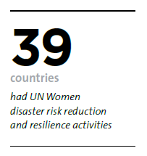
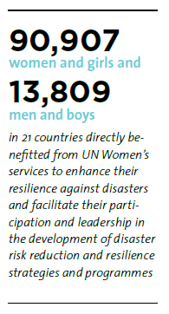
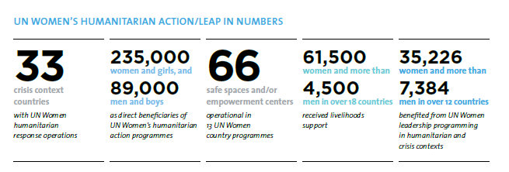
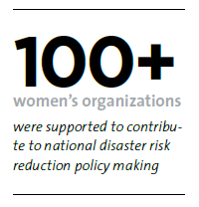
Catalytic programming
Delivered in partnership with 14 UN agencies, including UNFPA, OCHA, UNDP, UNICEF, UNHCR, WFP and UNDRR, 9 international NGOs and Red Cross/Crescent Societies and 493 local women organizations, 2 Private Sector Partners.
LEAP - Addressing immediate needs (Crisis Response): Restoring dignity, amplifying voices and leveraging leadership
Gender Responsive Disaster Risk Reduction:
Second Chance Education:
A humanitarian-development
nexus initiative responding to an
urgent gap

Slide 8
Management Response and Action
Recommendation 1: Develop a response-level strategy to complement UN Women’s global humanitarian strategy (RM strategy, annual reviews of GiHA)
Recommendation 2: Identify the necessary leadership, minimum levels of staffing and office structures for a response-level strategy in humanitarian settings to ensure UN Women can maximize its influence at the country level
UN Women currently reviewing country presence- Rightsizing offices.
Finalize the UN-Women Humanitarian Strategy, RM strategy [Initiated; Jan 2020];
Conduct internal annual reviews of Gender in Humanitarian Action – Gender Desk for the IASC [Ongoing; Q2. annually]
Techncial guidance on gender responsive localization, cash transfers, participation revolution and harmonized needs assessment, and rollout PSEA guidance [Initiated; Q4 2019]
Strenthen humanitarian content under UN Women’s global Knowledge Management Platform (SharePoint) [Ongoing; Q1.2020]
Strengthen UN Women internal expert deployment systems at global and regional level [Ongoing; Q4.2019]
Recommendation 3: Develop global partnership frameworks with OCHA, UNHCR and UNFPA building on experience in partnerships in different contexts
SMT engagement with UN OCHA, UNFPA and UNHCR to formalize framework agreements within the spirit of UN reforms [Not initiated; June 2020];
HACRO will engage with the AAP and PSEA lead agencies (OCHA, UNHCR, UNICEF) to ensure guidance provides specifics on W&Gs accessing AAP/PSEA in country level strategies. [Ongoing; June 2020]
Recommendation 4: Increase effectiveness and impact in humanitarian action by better linking UN Women’s work to system-wide responses while minimizing programming that is not done in partnership or that does not have broader strategic importance.
HACRO will develop field level coordination SOPs [Not Initiated; Q1. 2020];
HACRO will finalize the UNW humanitarian strategy and programme guidance with a clear criteria and checklist for prioritization of programmatic engagement [Initiated; Jan 2020]
UN-Women Crisis Management Protocols and Fast Track processes [Initiated; Q4 2019]
Capacity development trainings and thematic webinars. [Ongoing; Q2 2020] GiHA training already conducted in WCARO, APRO.
Capitalize on joint initiatives at global, regional and country level for scale up.
Partially accepted
Shift is contingent on backing and funding of an accountability and coordination mechanism for UN Women in Humanitarian Action.
Upscale of SIDA supported strategic partnership framework which enables UNW’s implementation of SP outcome 5
Limited core resources
Limited non-core for coordination capacities

Slide 9
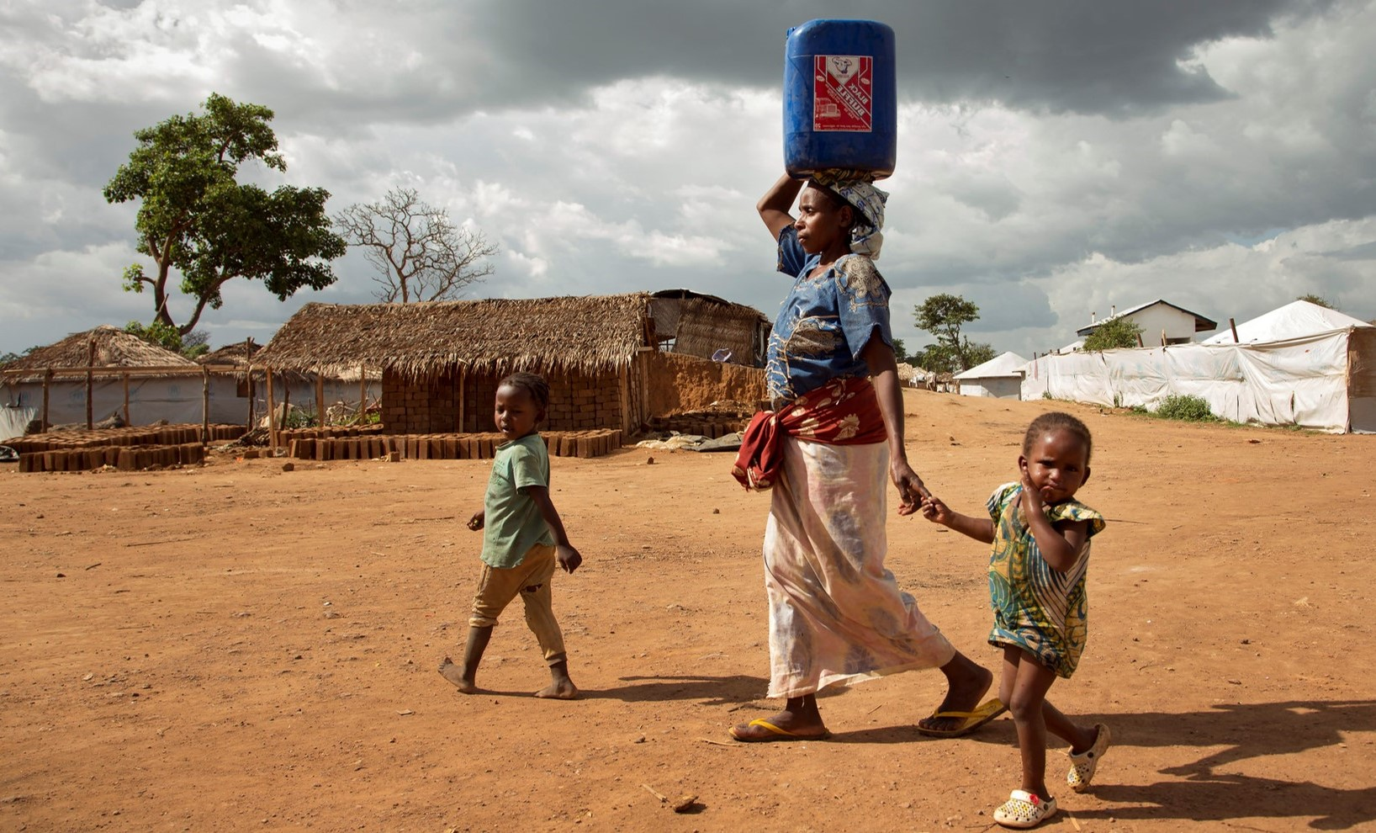
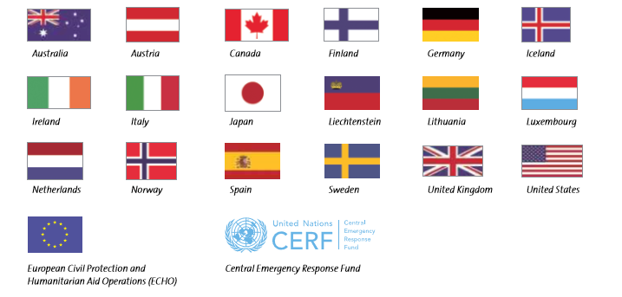

Going Forward
Sustain global engagement of UN Women in humanitarian and crisis related normative, policy and coordination mechanisms to promote accountability to GEEWG in humanitarian and recovery efforts
Link global policy and coordination strengths with country level efforts to bridge gaps between commitments and implementation in coordination and response planning.
Consolidate and leverage UN Women catalytic and transformative approach (hum-dev nexus) to maximize gender outcomes of the system at large.
Focus in fewer number of countries to reach scale and higher impact, continue to be the global advocate and supporter of localization and women’s leadership in humanitarian action and DRR
Strengthen partnership to maximize impact through system wide response and joint action at global, regional and country level.
Align strategy, structure, capacities and action with further support from donor base

Slide 10
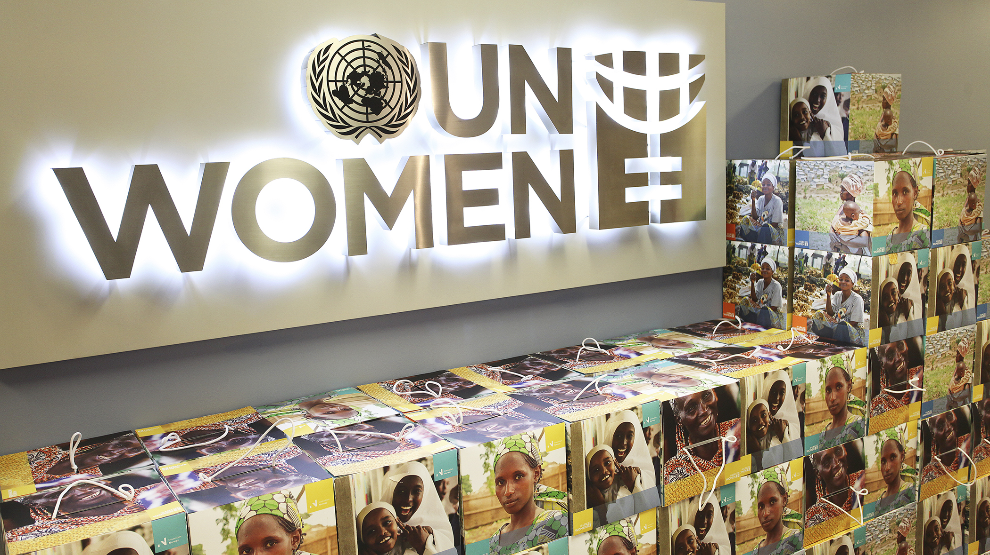
Thank you
Hiba Qasas
Chief, Humanitarian Action and Crisis Response Office, UN Women
Notes:
Refer to the upcoming Special Issue of the Oxfam Gender and Development Journal

